Slide 1




International University of Business Agriculture & Technology
PRACTICUM DEFENSE
M. M Rakibul Hasan
Assistant Professor
Supervised By :
Presentation On :
Restaurant Point of Sale System
Department of Computer Science & Engineering
Presentation By :
Sarder Rifat Rahman Bandhan
ID : 21303158
October 04, 2025

Slide 2
TOPICS
  Introduction
  Project Overview
  Process Model
  Requirement Engineering
  System Planning
  Risk Management
  Cost Estimation
  Designing / Analysis Modeling
  Demonstration
  Limitation
  Future Plan
  Conclusion
October 04, 2025

Slide 3

ORGANIZATION
Company Vision
"We code better life"
Concise, aspirational statement reflecting CODETREE's commitment to enhancing everyday experiences through smart, efficient, and life-enriching digital solutions
Company Mission
CODETREE is driven by a bold mission to unite the diverse expertise of designers, developers, and entrepreneurs under one roof—one tree—to deliver the best-quality digital outcomes tailored to client needs
CODETREE is an innovative and forward-thinking company that provides an array of services in Web Development & Solutions, Custom Software Development, Mobile Application Development, Digital Marketing, Cloud Hosting, Graphic Design, Point-of-Sale Systems, Inventory Management, School & College Management Systems, Donation Management Platforms, Bulk SMS Services, and IT Consultation.
Established in 2017, CODETREE has positioned itself as a leading software development company based in Dhaka, Bangladesh, with an international presence in Ontario, Canada. The company operates under the vision "We code better life", reflecting their commitment to enhancing everyday experiences through smart, efficient, and life-enriching digital solutions.
CODETREE
Location: House 73F, Road 12B, Sector 10, Uttara, Dhaka 1230, Bangladesh
Contact: Phone: 01710070606
Email: codetreebd@gmail.com
Working Hours: 09:00 AM – 06:00 PM

Slide 4

PROJECT OVERVIEW
  Built with modern web technologies (React.js frontend, Laravel backend, MySQL database), the system ensures reliable performance, secure data handling, and scalable restaurant management solutions.
  "Restaurant Point of Sale System for CODETREE" is responsible for managing all aspects of restaurant operations, including order management, inventory tracking, payment processing, and comprehensive reporting.
  This system helps restaurants automate their daily operations and eliminate manual errors that commonly occur in order taking, billing, and inventory management.
  The primary objective of the "Restaurant Point of Sale System" project is to automate restaurant workflows, streamline operations, reduce processing time, and enhance overall service quality.

Slide 5
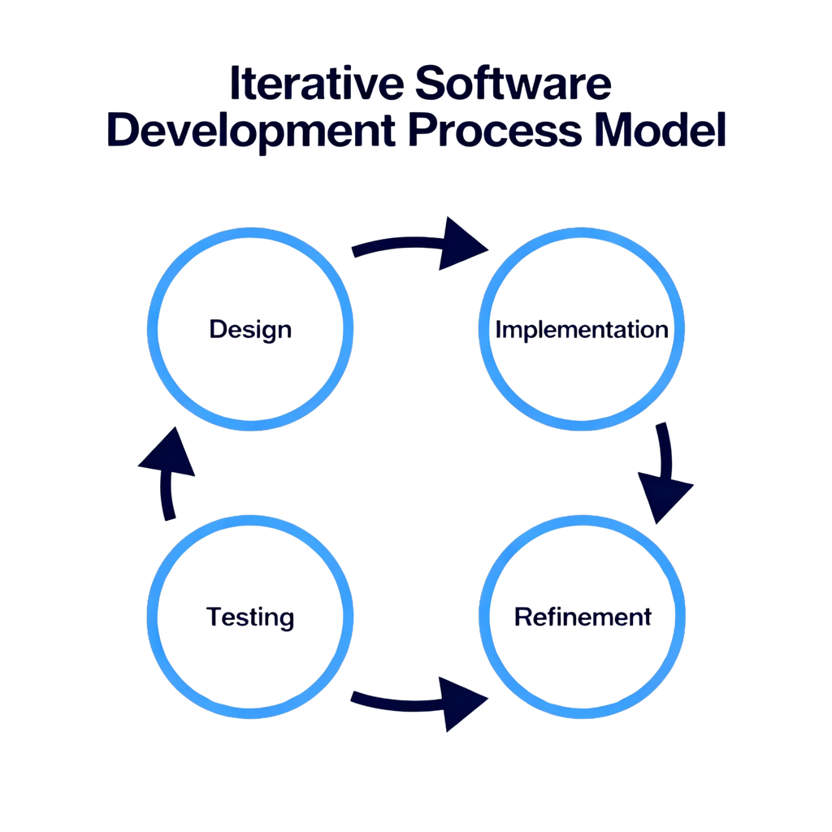
PROCESS MODEL
Fig : Iterative Process Model

Slide 6

PROCESS MODEL CONT...
Quick Response - Stakeholders can test each module independently.
Lower Risk - Thorough testing before integration reduces development failures.
Fast Delivery - Working modules generated quickly during development cycle.
Flexible Changes - Modify individual modules without system-wide impact.
Easy Error Fixes - Isolated testing identifies problems before integration.
Early Working Features - Restaurant can use POS functions immediately.
Staff Feedback - Real user input after each iteration improves usability.
Validated Accuracy - Multiple testing cycles ensure critical POS requirements.
Manageable Phases - Complex workflows broken into smaller development tasks.
Gradual Deployment - Core features first, advanced features added later.
Why the Iterative Model?

Slide 7

REQUIREMENT ENGINEERING
User Requirements
System Requirement
Functional Requirement
Non-Functional Requirement

Slide 8
REQUIREMENT ENGINEERING
User Requirements
(Admin Role Requirements):
  Secure Login - Access with protected credentials.
  Operations Management - Control orders, payments, and inventory.
  Menu Configuration - Set items, pricing, categories, and settings.
  Order Processing - Handle customer orders and payment transactions.
  Report Generation - Create daily, weekly, and monthly reports.
  Data Validation - Verify all restaurant data and system information.
  Inventory Control - Manage stock levels and supplier information.
  Activity Monitoring - Track restaurant activities and ensure accuracy.
  Full Authority - Add, modify, or remove system data and configurations.
  Customer Management - Handle customer data, order history, and feedback.

Slide 9

REQUIREMENT ENGINEERING CONT ...
System Requirement
Admin Login Process:
  Enter Credentials - Admin inputs username and password, clicks submit.
  Successful Login - Correct credentials grant direct dashboard access with full system control.
  Failed Login - Incorrect credentials display "invalid user info" error message.

Slide 10

REQUIREMENT ENGINEERING CONT ...
Functional Requirement
  Centralized Operations - Admin manages all restaurant operations from single interface
  Customer Database - Stores customer information, contact details, order preferences, and payment history
  Menu Management - Complete database with item details, pricing, categories, availability, and ingredients (admin-controlled)
  Order Processing - Handles orders from placement to completion with status tracking, payments, and receipts
  Inventory Control - Real-time management with automatic alerts, supplier tracking, and stock monitoring (admin-only)
  Business Reports - Generates sales analytics, inventory reports, and performance metrics (admin-exclusive

Slide 11
REQUIREMENT ENGINEERING CONT ...
Non-Functional Requirement
Performance Requirements:
  Responds within 5 seconds for all actions
  Handles up to 10,000 daily transactions
  Supports multiple admin sessions
  Fast data retrieval for analytics (<3 seconds)
Security Requirements:
  Data encryption for payments and sensitive info
  Role-based access with admin verification
  Audit logging of all actions and transactions
  Automatic secure daily backups
Reliability Requirements:
  99.9% system uptime with failover
  Graceful error handling and recovery
  Ensures data integrity for orders, payments, inventory
  Fast backup and recovery

Slide 12
REQUIREMENT ENGINEERING CONT ...
Non-Functional Requirement
Usability Requirements
  Intuitive, user-friendly interface
  Simple, minimal-training navigation
  Easy-access dashboards for key functions
  Clear confirmation and validation messages
Scalability Requirements
  Supports 200% transaction/database growth
  Expandable storage for menus, customers, history
  Modular, easily expandable features
Maintainability Requirements
  Clean, well-documented code (React.js, Laravel, MySQL)
  Easy updates and bug fixes
  Built-in monitoring tools
Portability Requirements
  Works on desktop, tablet, mobile (web-based)
  Compatible with major browsers
  Runs on multiple operating systems

Slide 13
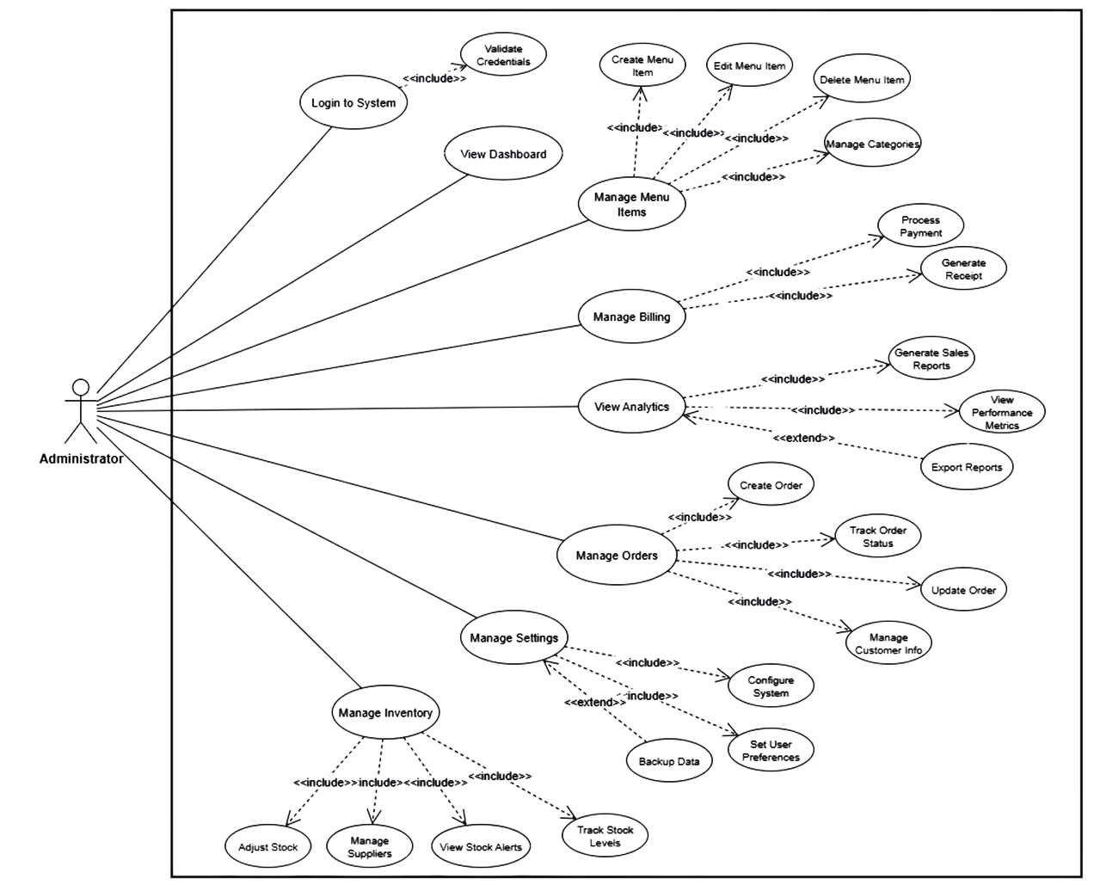
USE CASE DIAGRAM
Actors: Admin

Slide 14
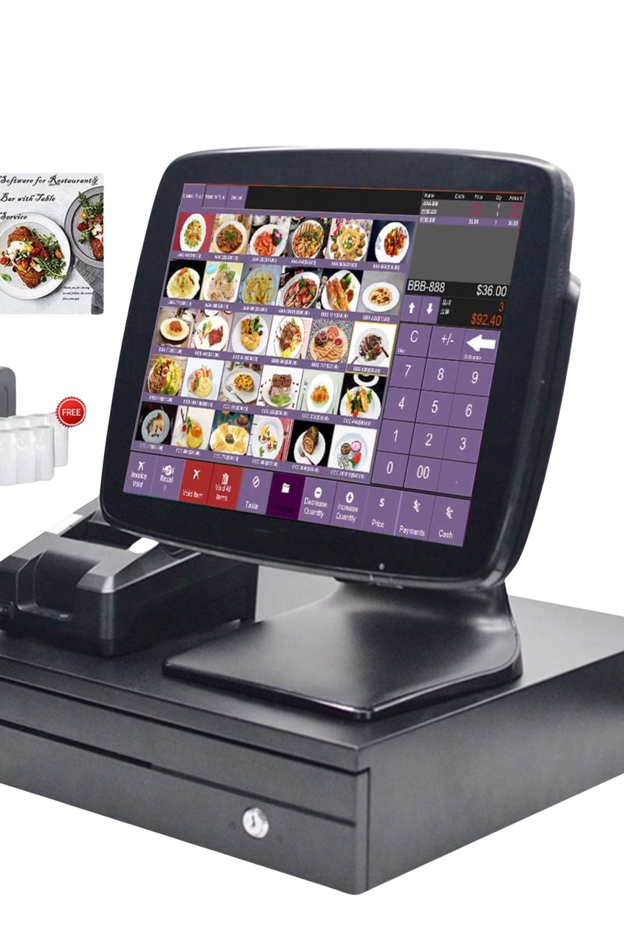
Function Point Estimation for POS System
A comprehensive analysis of software estimation techniques for restaurant management systems, including function point analysis, project scheduling, and cost estimation.

Slide 15
FUNCTION POINT ESTIMATION
Function Point Estimation (FPE) is a standard technique used to measure the size and complexity of a software application from the user's perspective. For the POS System for Restaurants, FPE is used to evaluate the system's functional components, focusing on order processing, payment handling, inventory management, and reporting.
Functionality, Input, Output
Functionality
Input
Output
1. User Management
User details, role assignments
Confirmation Message or Error Message
2. Menu Management
Menu items, pricing, categories
Confirmation Message or Error Message
3. Order Processing
Order details, customer preferences
Order confirmation, receipt
4. Payment & Receipts
Payment details (cash, card, etc.)
Payment confirmation, receipt
5. Inventory Management
Stock levels, menu items, orders
Inventory updates, low stock alerts
6. Sales Reporting
Date range, report type
Sales report (daily, weekly, monthly)
7. End of Day Process
Day-end command
Database backup, sales export
8. Customer Feedback
Customer feedback
Feedback confirmation, report

Slide 16
IDENTIFY COMPLEXITY
Identify Complexity of Transaction Functions (TF)
Functionality
Input
Output
Functionality
Input
1 User Management
User details, role assignments
Confirmation Message or Error Message
User Management
User details, role assignments
2 Menu Management
Menu items, pricing, categories
Confirmation Message or Error Message
Menu Management
Menu items, pricing, categories
3 Order Processing
Order details, customer preferences
Order confirmation, receipt
Order Processing
Order details, customer preferences
4 Payment & Receipts
Payment details (cash, card, etc.)
Payment confirmation, receipt
Payment & Receipts
Payment details (cash, card, etc.)
5 Inventory Management
Stock levels, menu items, orders
Inventory updates, low stock alerts
Inventory Management
Stock levels, menu items, orders
6 Sales Reporting
Date range, report type
Sales report (daily, weekly, monthly)
Sales Reporting
Date range, report type
7 End of Day Process
Day-end command
Database backup, sales export
End of Day Process
Day-end command
8 Customer Feedback
Customer feedback
Feedback confirmation, report
Customer Feedback
Customer feedback

Slide 17
IDENTIFY COMPLEXITY
Identify Complexity of Data Functions (DF)
Data Function
Type
RET
DET
Complexity
1 Users
ILF
1
7
Low
2 Menu Items
ILF
1
8
Low
3 Orders
ILF
1
12
Low
4 Transactions
ILF
1
10
Low
5 Stock
ILF
1
6
Low
6 Reports
ILF
1
9
Low

Slide 18
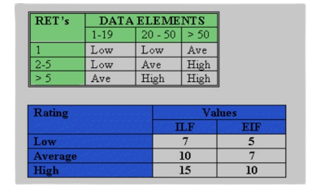
Unadjusted Function Point Contribution

Slide 19
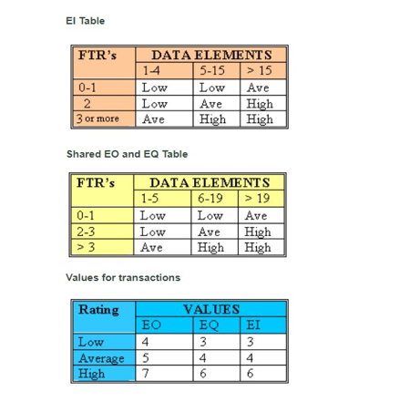
Table shows how much each transaction function adds to the total function points.
UFP OF TF
Transaction Function
TF
FTR
DET
Complexity
UFP
1. User Management
EI
1
3
Low
3
2. Menu Management
EI
2
5
Avg
4
3. Order Processing
EI
2
6
Low
4
4. Payment & Receipts
EI
2
6
Low
4
5. Inventory Management
EI
2
4
Low
3
6. Sales Reporting
EO
2
3
Low
4
7. End of Day Process
EI
1
2
Low
3
Table: shows the unadjusted function point contribution of data functions.
8. Customer Feedback
EO
1
3
Low
4
                Total UFP (TF) 35

Slide 20
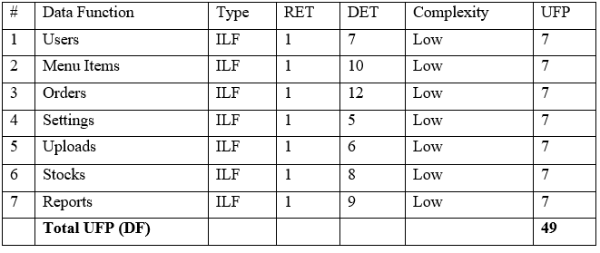
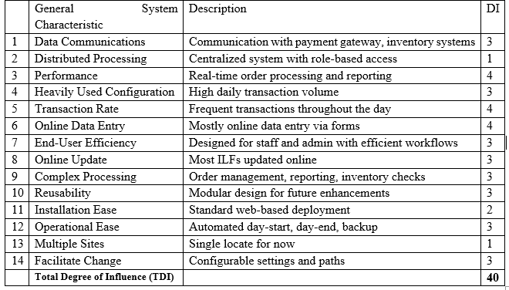
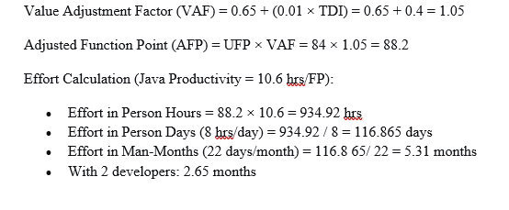
UFP OF DF
Total UFP
CALCULATION OF TOTAL DEGREE OF INFLUENCE (TDI) :
UFP(TF) + UFP(DF) = 35 + 49 = 84
Final Calculation
3
1
3

Slide 21

Project Scheduling
The project is planned to be completed in 12 weeks (3 months). Below is the Gantt chart illustrating the schedule:

Slide 22
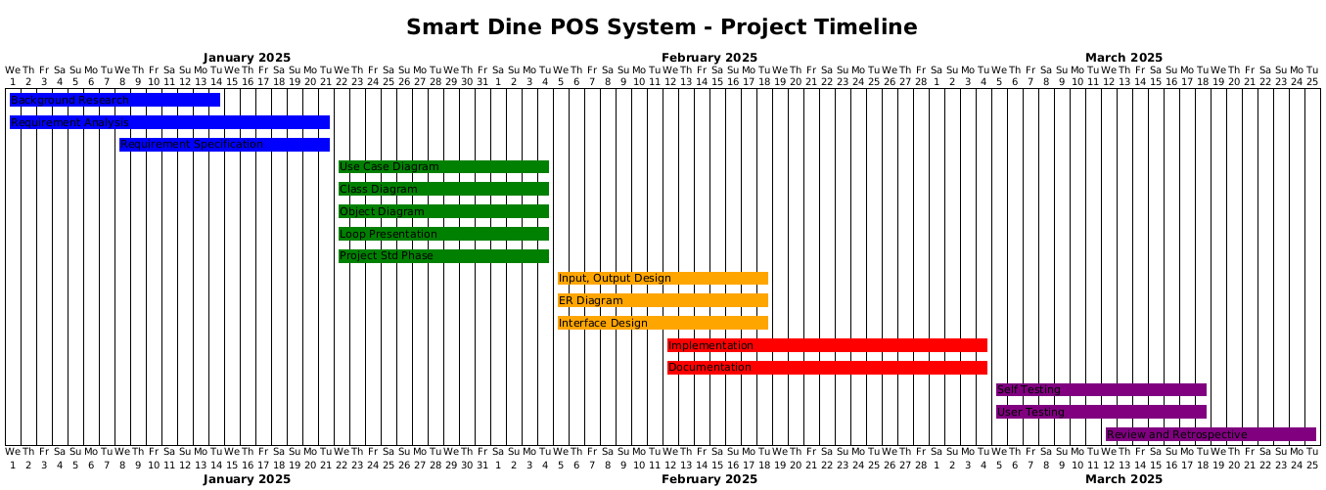
Project Scheduling

Slide 23
PROJECT PHASES AND TIMELINE
01
02
03
Planning & Requirement Gathering
Analysis Modelling
Design
Conduct background research and study
Complete requirements analysis
Prepare requirements specification in week 3
Create use case, class, and object diagrams
Present demo in week 5
ER and DFD design in week 5
Input/output design in week 6
04
05
Coding
Testing
Main coding and documentation phase
Self-testing in week 10
Reviews and retrospective in weeks 11–12

Slide 24
KEY PROJECT MILESTONES
Week 3: Requirements specification completed
1
2
Week 6: System design finalised
Week 8: Core functionality implementation
3
4
Week 10: Alpha version testing begins
Week 12: Final system delivery and documentation
5
Resource Allocation:
  Weeks 1-3: Business analysts and stakeholders
  Weeks 4-6: System architects and designers
  Weeks 7-10: Development team (Frontend & Backend)
  Weeks 11-12: QA team and end users

Slide 25
THE RMMM PLAN FOR RESTAURANT POS SYSTEMS
A comprehensive risk management framework designed specifically for restaurant Point of Sale system development and operations.

Slide 26
UNDERSTANDING RMMM FRAMEWORK
Risk Mitigation
Risk Monitoring
Risk Management
Proactive planning to prevent risks before they occur in your POS system
Continuous assessment of system performance and emerging threats
Immediate response actions when mitigation fails and risks materialize
Each component works together to ensure your restaurant POS system remains resilient and operational during critical business hours.

Slide 27
RISK MITIGATION: PREVENTION FIRST
01
02
Automated Backup Systems
Role-Based Access Controls
Implement robust backup protocols during day-end processes to protect transaction data and prevent revenue loss.
Establish secure user management with granular permissions to protect sensitive customer and financial data.
03
04
Database Integrity Checks
Payment Testing Protocols
Schedule regular validation processes to ensure order data remains accurate and consistent across all systems.
Establish comprehensive testing procedures for payment processing functionality before deployment.

Slide 28
INVENTORY TRACKING ACCURACY
Key Monitoring Points
99.7%
15MIN
  Real-time stock level updates
  Ingredient usage patterns
Accuracy Target
Update Frequency
  Waste tracking and reporting
  Supplier integration status
Inventory tracking precision goal
Real-time sync intervals
Continuous evaluation prevents stock discrepancies that could impact menu availability and customer satisfaction.

Slide 29
Risk Management: When Prevention Fails
EMERGENCY RESPONSE PROTOCOLS
When mitigation strategies fail and risks become live problems, immediate action is critical. Your POS system needs predefined response procedures that can be executed quickly and effectively.
System Failure Response
Payment Gateway Backup
Rollback mechanisms to restore order data and maintain transaction integrity
Alternative processing methods when primary systems fail
Manual Override Procedures
Emergency protocols for continued operations during downtime

Slide 30
EMERGENCY RESPONSE IMPLEMENTATION
1
Immediate Response (0-2 min)
Activate backup payment processing, switch to manual order tracking, notify management of system status.
2
Short-term Actions (2-15 min)
Deploy alternative inventory tracking, implement paper-based backup procedures, contact technical support.
3
Recovery Phase (15+ min)
Execute rollback mechanisms, validate data integrity, conduct post-incident analysis for future improvements.

Slide 31






BUILDING RESILIENT POS SYSTEMS
Continuous Monitoring
Real-time oversight ensures early detection of potential problems
Proactive Mitigation
Prevent issues before they impact operations through robust system design
Rapid Response
Quick action protocols minimize downtime and protect revenue
The RMMM framework provides a comprehensive approach to risk management that keeps your restaurant POS system operational when it matters most.

Slide 32

ANALYSIS MODELLING

Slide 33
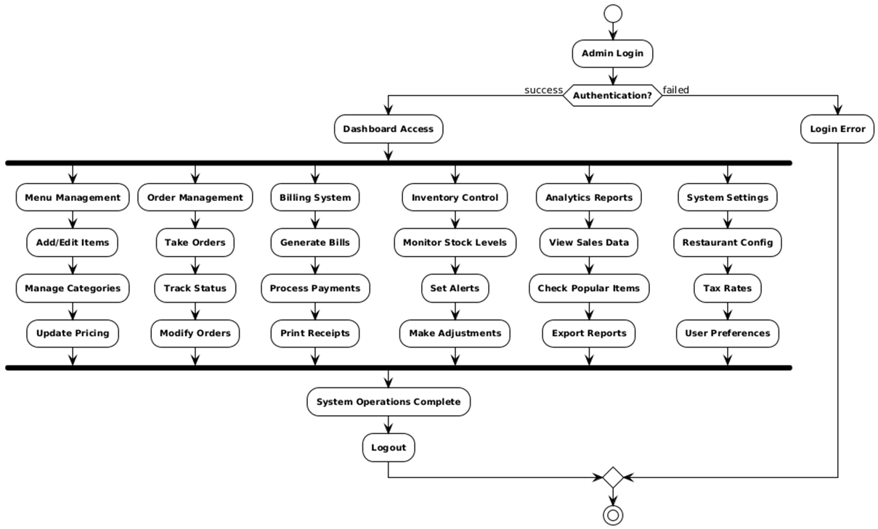
Activity Diagram for admin
Fig : Activity Diagram for admin

Slide 34
SWIM LANE DIAGRAMS

Slide 35
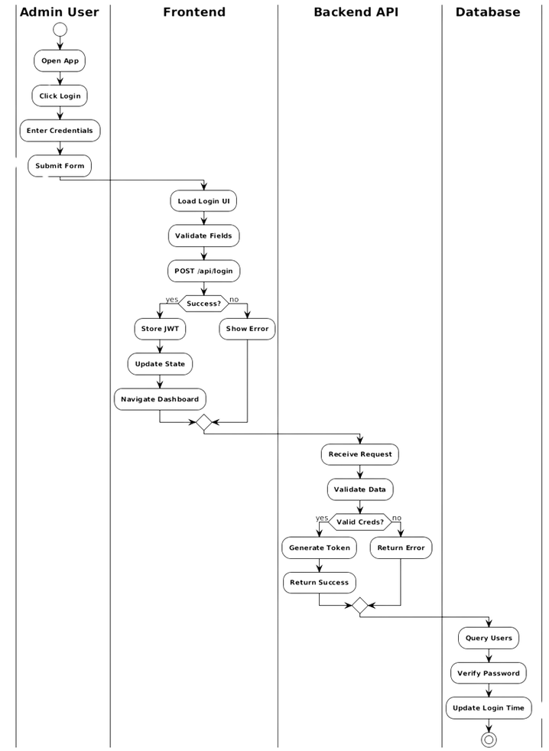
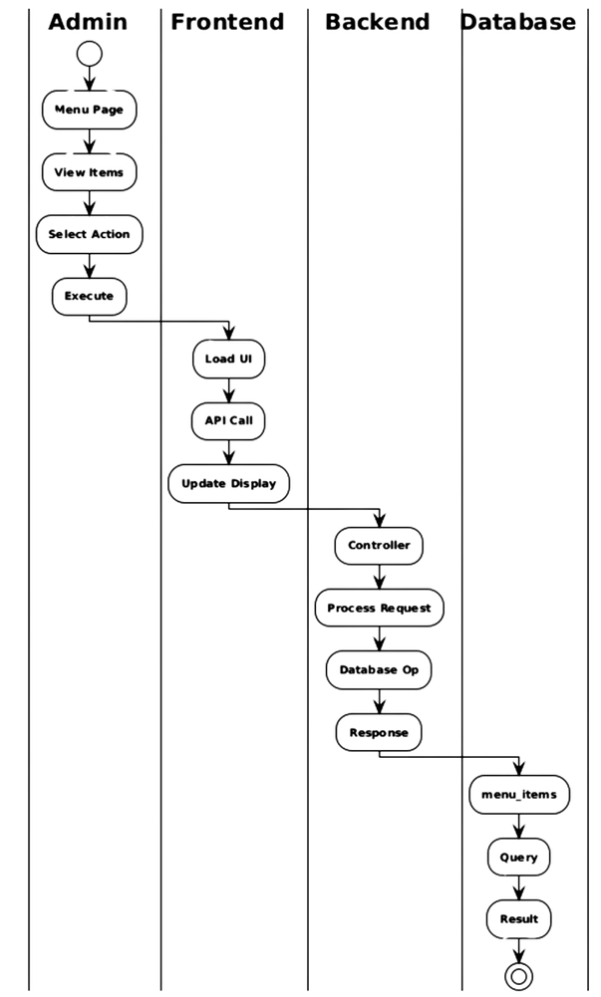
Swim-lane Diagram for Authentication & Login Process
Swim-lane Diagram for Menu Management
Fig : Swim-lane Diagram for Authentication & Login Process
Fig : Swim-lane Diagram for Menu Management

Slide 36
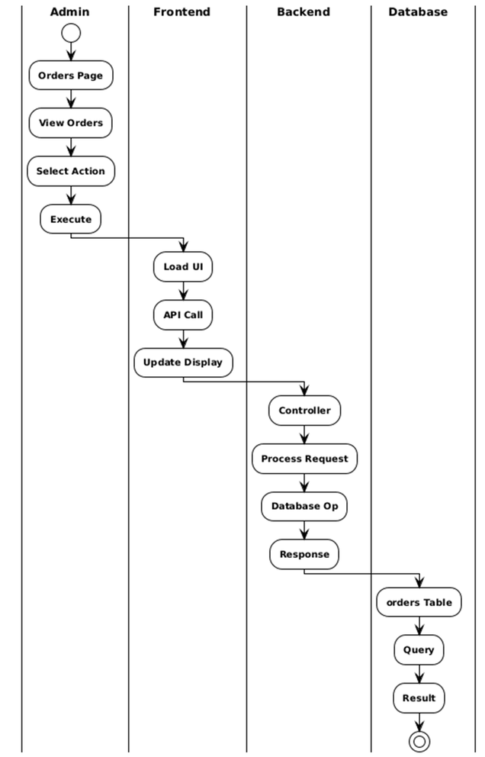
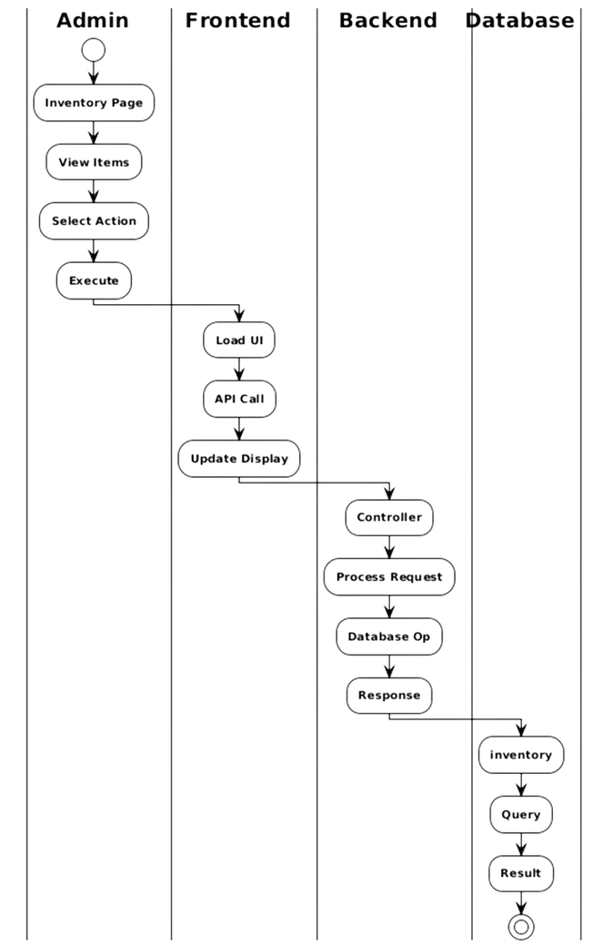
SWIM-LANE DIAGRAM FOR ORDER PROCESSING
SWIM-LANE DIAGRAM FOR INVENTORY MANAGEMENT
Fig : Swim-lane Diagram Order Processing
Fig : Swim-lane Diagram for Inventory Management

Slide 37
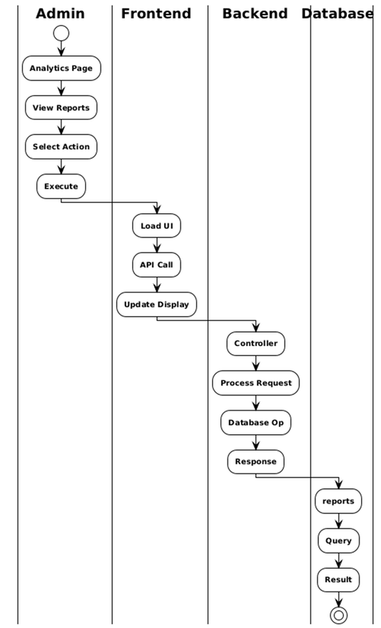
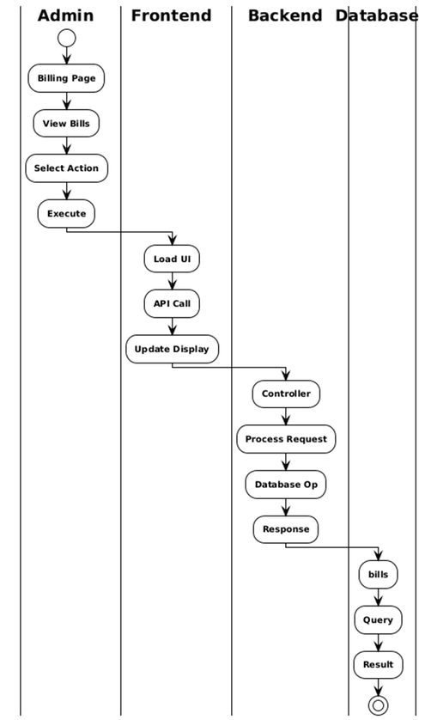
Swim-lane Diagram for Report & Analytics
Swim-lane Diagram for Billing Module
Fig : Swim-lane Diagram for Report & Analytics
Fig : Swim-lane Diagram for Billling Module

Slide 38
Class Diagram

Slide 39
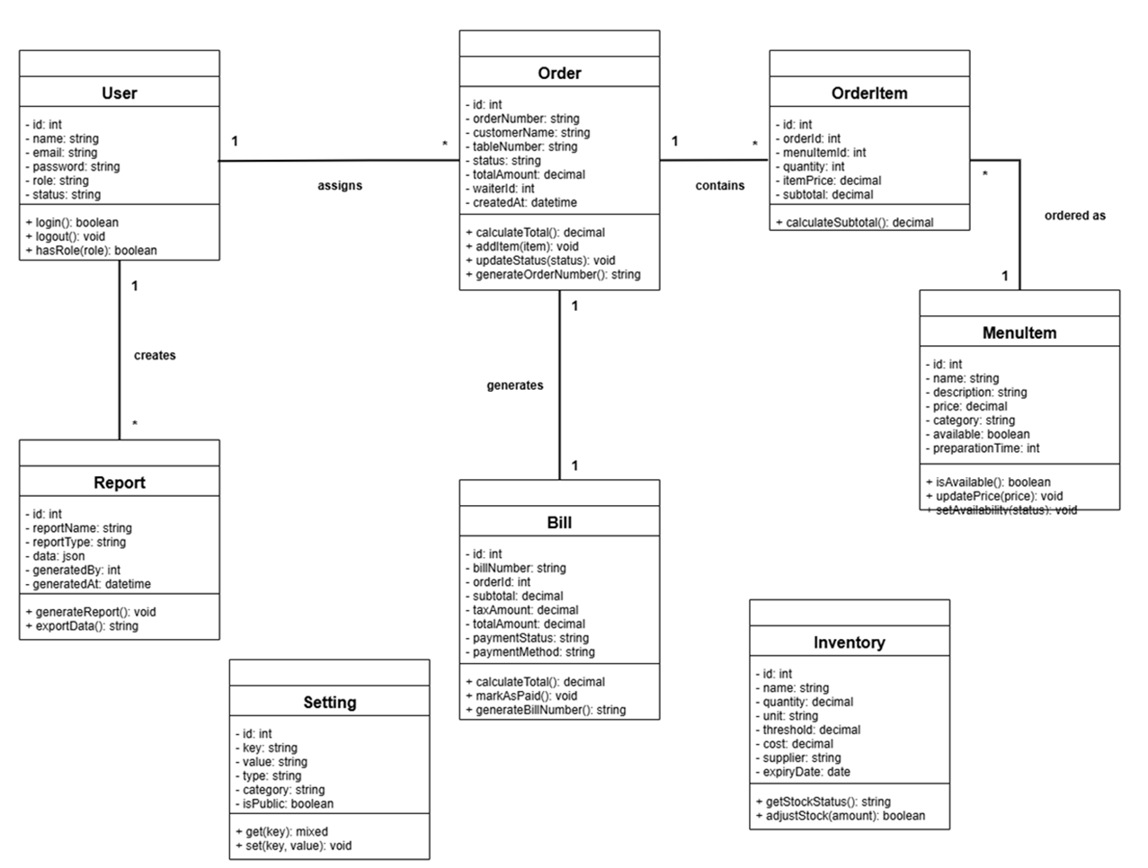
Class Diagram for Restaurant POS System
Fig : Class Diagram for Restaurant POS System

Slide 40
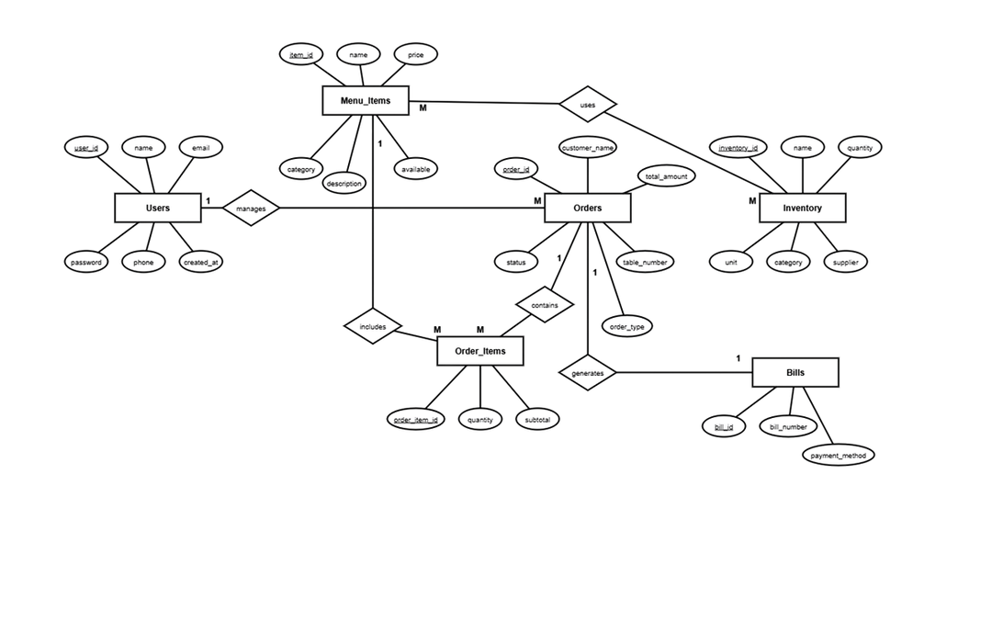
ERD Diagram
Fig : ERD for Restaurant POS System

Slide 41
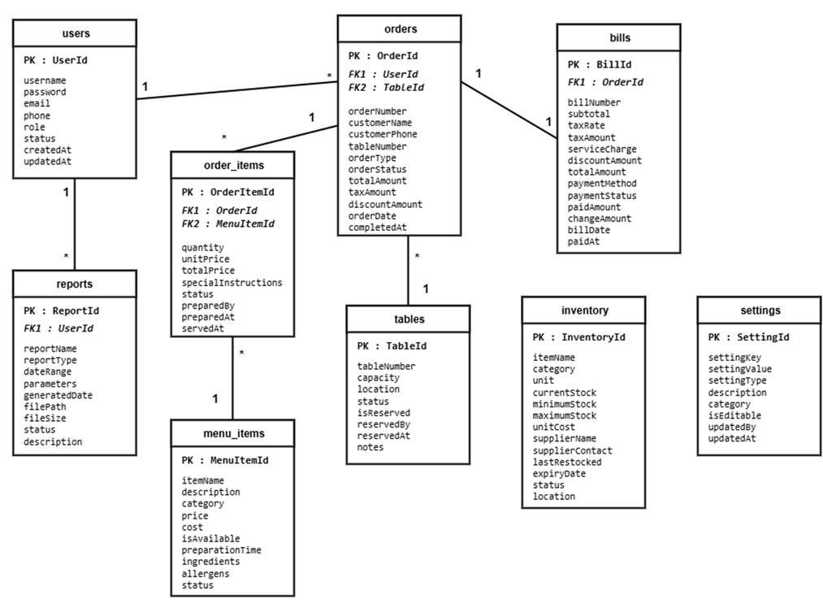
Database Design
Fig : Database for Restaurant POS System

Slide 42
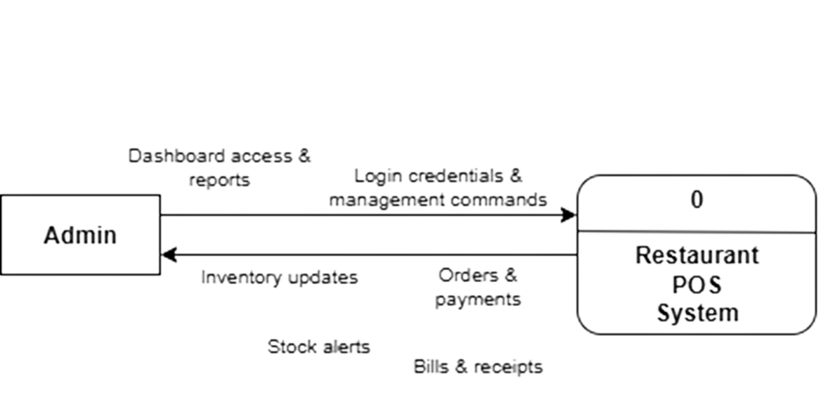
Data Flow Diagram
Fig : Illustrates the context-level DFD 0 and shows the actors and process.

Slide 43
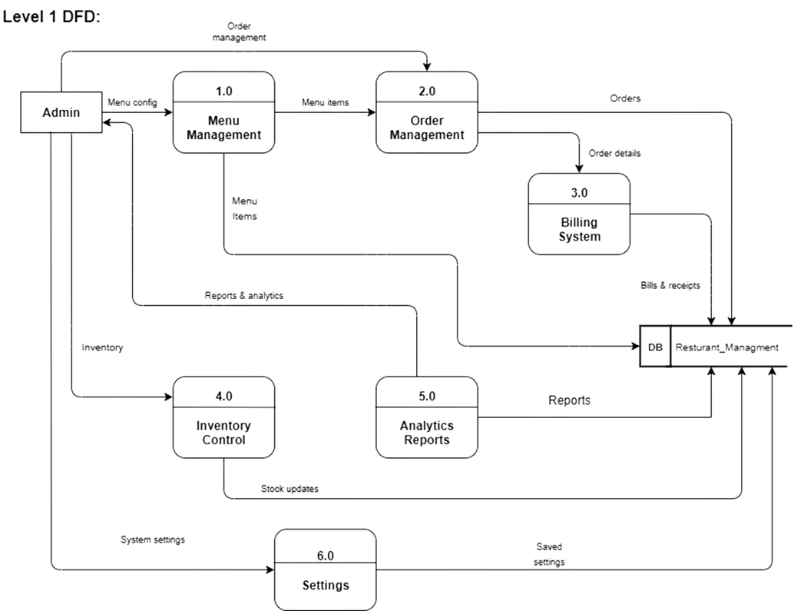
Level 1 (DFD) :
Fig : Level 1 DFD Admin Panel.

Slide 44
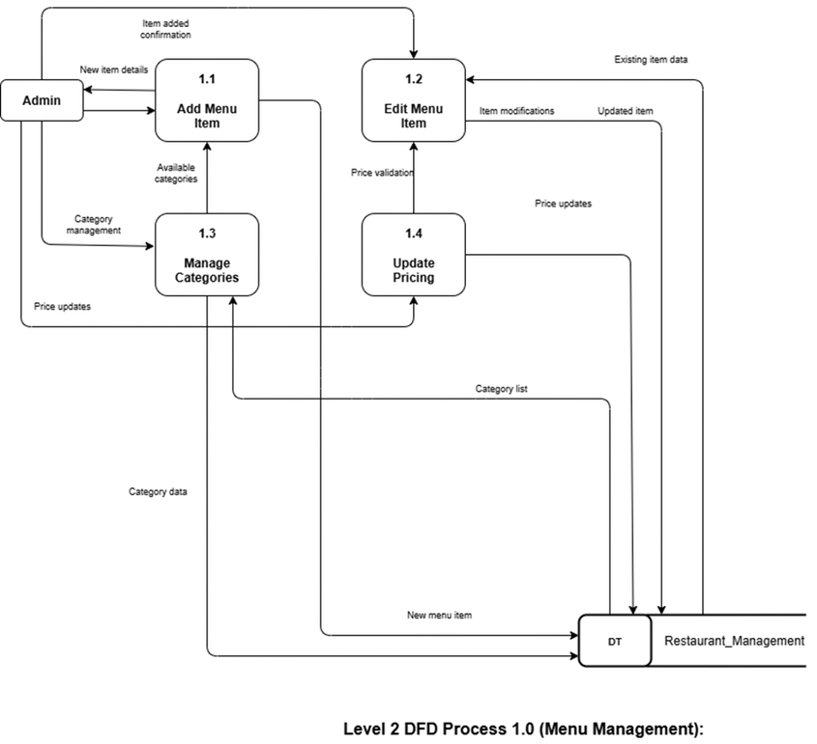
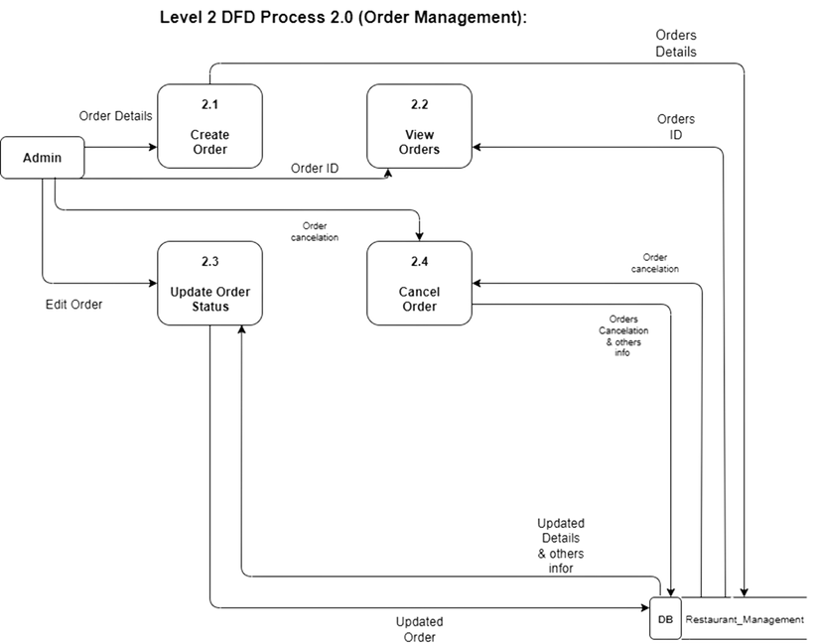
Level 2 DFD Process 1
Level 2 DFD Process 2
Figure: Level 2 DFD Process 1 Menu Module.
Figure: Level 2 DFD Process 2 Order Module.

Slide 45
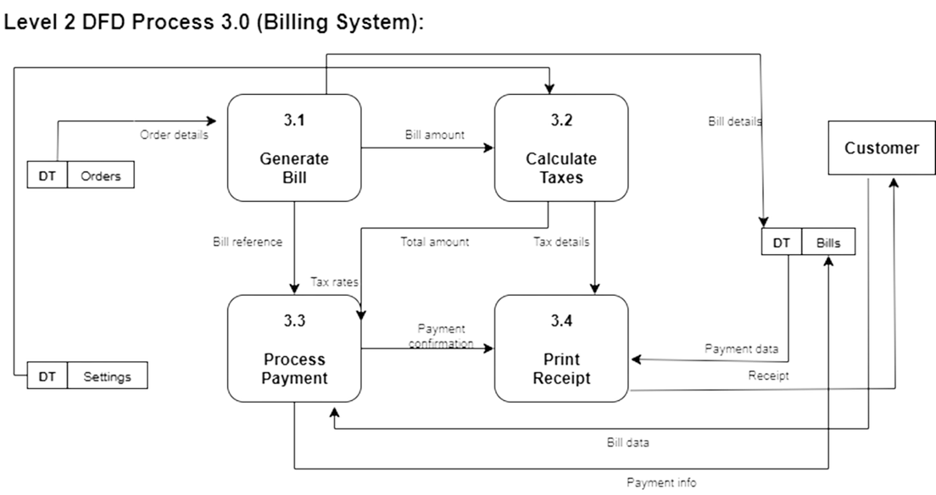
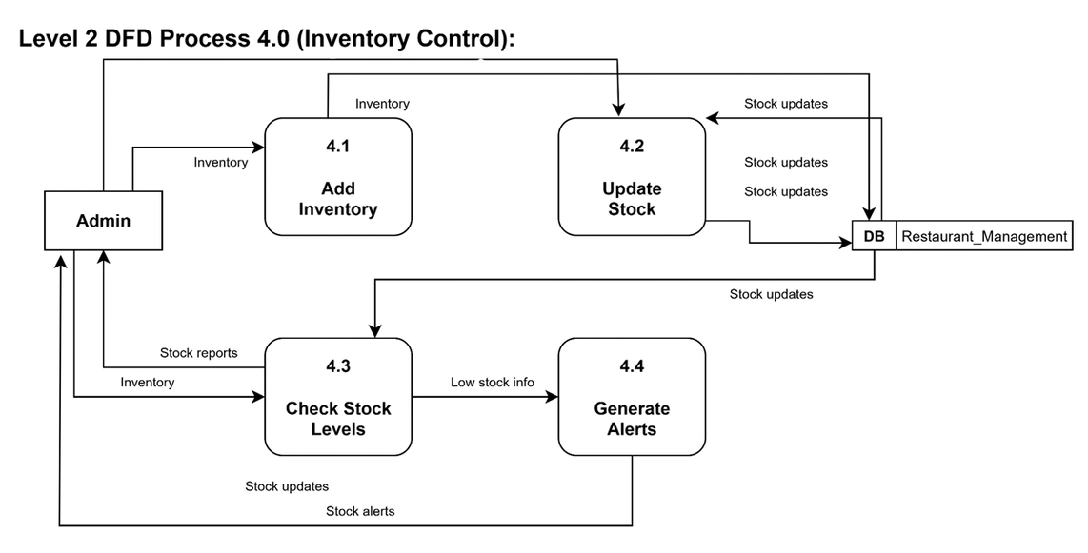
Level 2 DFD Process 3
Level 2 DFD Process 4
Figure: Level 2 DFD Process 3 Billing Module.
Figure: Level 2 DFD Process 4 Inventory Module.

Slide 46
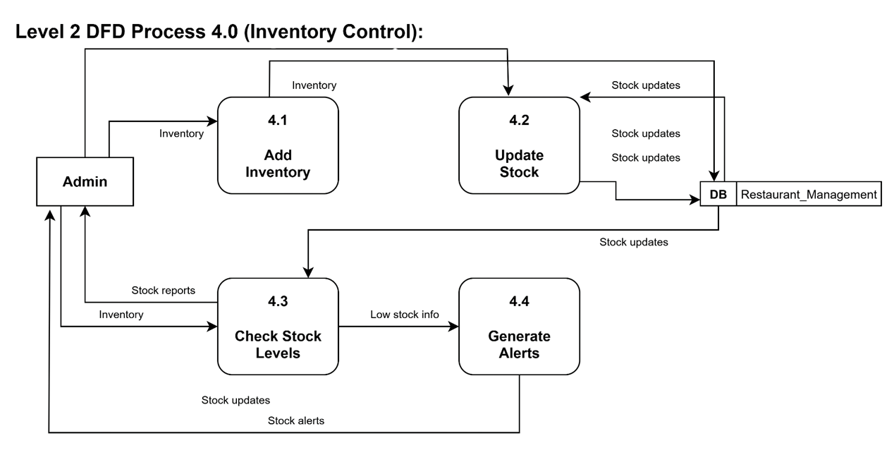
Level 2 DFD Process 5
Figure: Level 2 DFD Process 5 Settings Module.

Slide 47


Slide 48
LIMITATIONS
Despite its strong features, the current Restaurant POS System has some limitations:
Scalability Constraints:
External System Integration:
Mobile Accessibility:
The system works well for current transaction volumes but future growth in restaurant size or transaction volume may require additional optimization and scaling efforts
Currently relies on manual processes or file-based integrations for tasks like supplier data updates or accounting software integration
System is primarily desktop-focused with limited mobile-responsive features
Staff cannot access full functionality from mobile devices during service
Limited API-based integrations could streamline these processes
Real-time Features:
Advanced Analytics:
Basic dashboard functionality without advanced live updates
Current reporting focuses on basic sales and inventory data
Limited real-time notifications for critical restaurant operations
Lacks predictive analytics for demand forecasting and customer behavior analysis

Slide 49

Future Work
To exceed present limitations and improve the system, the following areas are suggested for future enhancement:

Slide 50



Performance and Scalability Enhancement:
Real-Time Features:
Advanced Integration:
Developing a live dashboard using web technologies for real-time insights into sales, order statuses, inventory levels, and critical alerts for restaurant managers and staff
Replacing file-based data transfers with secure RESTful APIs or direct integrations for payment gateways, inventory suppliers, and accounting systems
Migrating to cloud-based infrastructure or using optimized database solutions (e.g., cloud MySQL)
Implementing caching mechanisms such as Redis to improve performance for higher transaction volumes
Automating workflows to increase system reliability

Slide 51
CONCLUSION
Project Success and Impact:
The development of the Restaurant Point of Sale System for CODETREE was a comprehensive and successful practicum that provided invaluable real-world experience in designing a business application. Built with React.js, Laravel, and MySQL, the system successfully automates day-to-day restaurant operations including order management, inventory tracking, payment processing, and reporting.

Slide 52
Technical Achievement:
The project demonstrated effective integration of modern web technologies, creating a robust system that handles all aspects of restaurant operations with minimal manual intervention. The iterative development approach ensured high quality through continuous testing and stakeholder feedback.
Business Value:
The system significantly enhances operational efficiency, reduces manual errors, improves customer satisfaction, and provides restaurant owners with confidence to run their businesses smoothly. The automated reporting capabilities enable data-driven decision making for restaurant management.
Learning Outcomes:
This practicum provided comprehensive experience in full-stack development, database design and management, business logic implementation, security and compliance, and project management. The skills acquired include React.js and Laravel expertise, MySQL optimization, restaurant workflow automation, and professional software development practices.
Future Ready:
The current system provides a solid foundation for continued enhancement and evolution. With planned improvements in scalability, mobile accessibility, and advanced analytics, the system is positioned to grow with restaurant business needs and technological advancements.
The Restaurant POS System successfully meets its objectives of enhancing efficiency, transparency, and reliability in restaurant operations while providing a platform for future technological innovation in the food service industry.

Slide 53
THANK YOU SO MUCH!
Presentation By: Sarder Rifat Rahman Bandhan
ID : 21303158
October 04, 2025

